Slide 1
INGLÊS TÉCNICO – AULA 7
MARCELA HARDMAN

Slide 2
CONJUNÇÕES
Conjunções são termos utilizados para relacionar duas sentenças ou dois termos semelhantes (ou de mesma função). Podem ter mais de uma palavra (locuções conjuntivas) e sua função é a de introduzir orações coordenadas e subordinadas.

Slide 3
Coordinating Conjunctions (Conjunções Coordenativas)
.
Elas conectam elementos de mesma importância: palavras, frases ou orações independentes.
Principais (lembre-se do acrônimo FANBOYS):
For (pois)
And (e)
Nor (nem)
But (mas)
Or (ou)
Yet (ainda assim, porém)
So (então)

Slide 4
Exemplos:
I like Python, and I also enjoy Java.
The code is clean, but it needs more comments.
You can use JavaScript, or you can choose TypeScript.
It’s late, so we should finish this tomorrow.
He didn’t study, yet he passed the exam

Slide 5
Subordinating Conjunctions (Conjunções Subordinativas)
Ligam uma oração principal a uma oração subordinada, indicando causa, tempo, condição, etc.
Principais:
Because (porque)
Although / Though (embora)
If (se)
When (quando)
While (enquanto)
Unless (a menos que)
Since (desde que / porque)
As (como / enquanto / porque)
Before / After (antes / depois)

Slide 6
Exemplos:
The server crashed because there was a memory leak.
Although the algorithm is efficient, it uses too much memory.
You won’t succeed unless you practice regularly.
If you don’t close the connection, the system may crash.
We tested the software after updating the drivers.

Slide 7
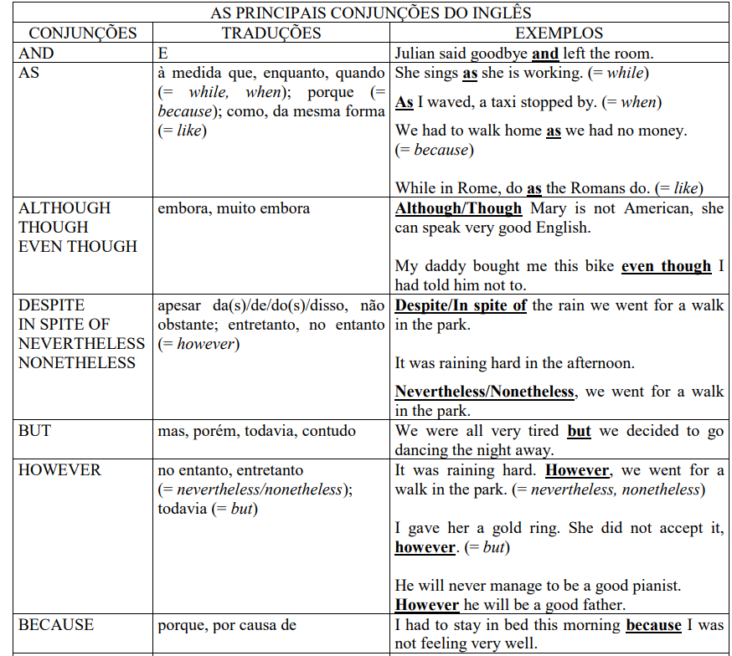

Slide 8
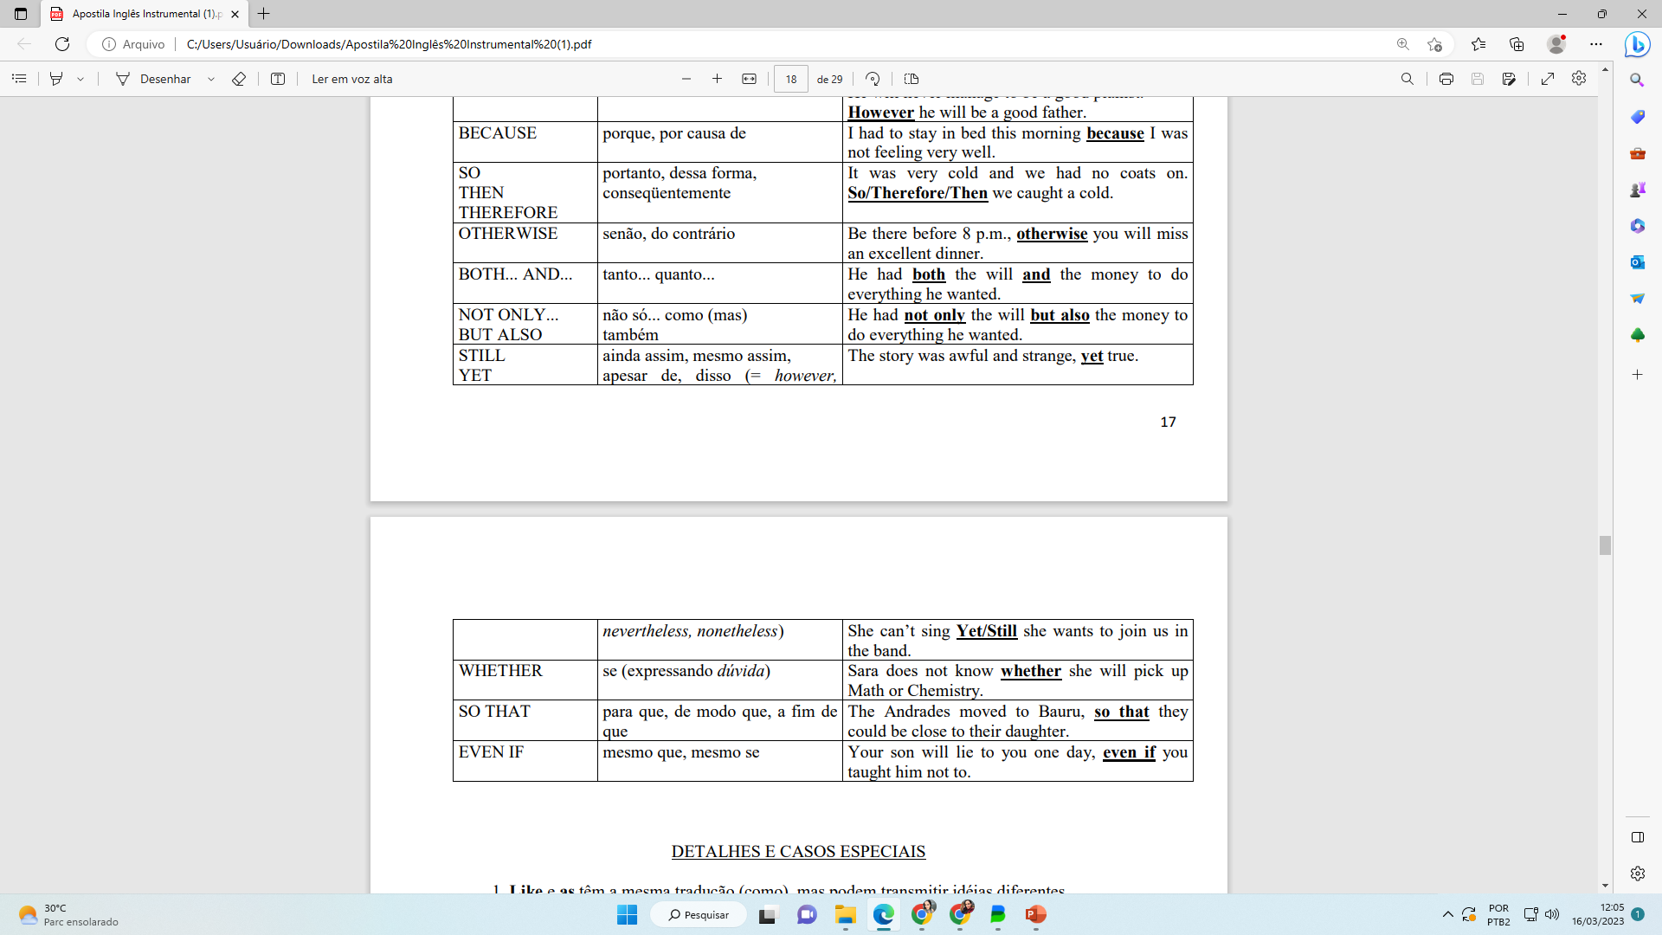

Slide 9
DETALHES E CASOS ESPECIAIS
1. Like e as têm a mesma tradução (como), mas podem transmitir idéias diferentes.
She’s worked like a maid. (= ela trabalhou como se fosse uma empregada)
She’s worked as a maid. (= ela trabalhou como empregada, ela era empregada)
2. For pode ser sinônimo de because, embora com algumas restrições (não pode ser precedido de not, de but ou qualquer outra conjunção e não pode ser usado para responder uma pergunta).
The boys will return soon, for they must be hungry by now.

Slide 10
3. As conjunções when, by the time (quando), till, until (até), after (após, depois), before (antes), as soon as (logo que, assim que) e as long as (enquanto, contanto que) são utilizadas principalmente para relacionar Tenses, os tempos verbais em inglês.
When/By the time we finished our work all the other students had left.
Send me a postcard from Germany as soon as you can, will you?
I don’t mind your getting late, as long as it doesn’t interfere with our deadlines.

Slide 11
respondam os exercícios para praticar

Slide 12
Exercício 1
Escolha a conjunção correta (and, but, or, so) para completar as frases abaixo:
Programming languages like Python are easy to learn, ___ they are very powerful for complex tasks.
You can use JavaScript for front-end development, ___ you can choose Python for back-end development.
The system is running efficiently, ___ we still need to test for bugs.
You should study algorithms, ___ you might struggle with complex problem-solving.

Slide 13
Exercício 1 - resolvido
Programming languages like Python are easy to learn, and they are very powerful for complex tasks.
You can use JavaScript for front-end development, or you can choose Python for back-end development.
The system is running efficiently, but we still need to test for bugs.
You should study algorithms, or you might struggle with complex problem-solving.

Slide 14
Exercício 1I
Complete as frases usando "because" ou "so":
The server crashed ___ there was a memory overflow.
We upgraded the system ___ it could handle more simultaneous users.
The program didn’t work ___ there was a syntax error.
You should comment your code ___ other developers can understand it better.

Slide 15
Exercício 1I - Resolvido
The server crashed because there was a memory overflow.
We upgraded the system so it could handle more simultaneous users.
The program didn’t work because there was a syntax error.
You should comment your code so other developers can understand it better

Slide 16
Exercício 1II
Escolha entre "although", "while", "since", "if" ou "unless" para completar as frases:
___ Python is slower than C++, it is easier to write and debug.
___ you have the necessary permissions, you can access the admin panel.
___ learning to code can be challenging, it becomes easier with practice.
___ you optimize your code, the program will run slowly

Slide 17
Exercício 1II - Resolvido
Although Python is slower than C++, it is easier to write and debug.
If you have the necessary permissions, you can access the admin panel.
While learning to code can be challenging, it becomes easier with practice.
Unless you optimize your code, the program will run slowly.

Slide 18
The computing job market is rapidly expanding, and it offers many opportunities for professionals in various fields. Companies are looking for skilled workers who can develop software, manage databases, or maintain network systems. Because technology evolves quickly, staying updated is essential, so many professionals continue learning throughout their careers. Although competition can be strong, there is still a high demand for those with specialized knowledge. Therefore, students should focus on both technical skills and problem-solving abilities to succeed.

Slide 19
The computing job market is rapidly expanding, and it offers many opportunities for professionals in various fields. Companies are looking for skilled workers who can develop software, manage databases, or maintain network systems. Because technology evolves quickly, staying updated is essential, so many professionals continue learning throughout their careers. Although competition can be strong, there is still a high demand for those with specialized knowledge. Therefore, students should focus on both technical skills and problem-solving abilities to succeed.

